Slide 1
To Do App
WELCOME TO MY PRESENTATION

Slide 2
GITHUB LINK
https://github.com/ElgunRealShamistanGazanfar/FinalProject_ToDo/tree/Shamistan

Slide 3
TECHNOLOGIES
SPRING BOOT
THYMELEAF
SPRING SECURITY
HIBERNATE/RELATIONSHIP
LIQUIBASE
POSTGRESQL
LOGGER

Slide 4
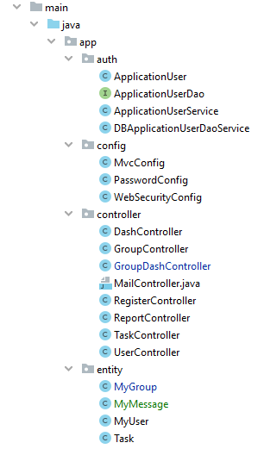
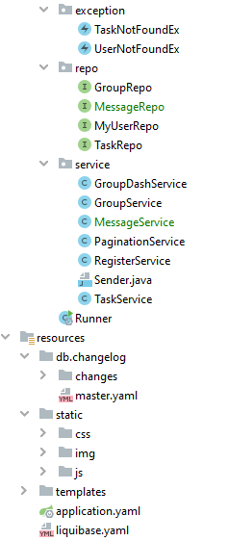
GENERAL CODE STRUCTURE

Slide 5
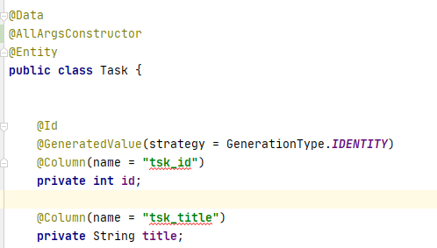
LOGGER AND LOMBOK

Slide 6
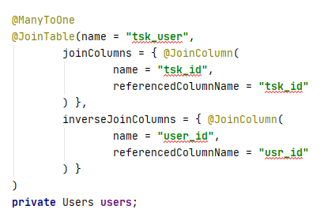


RELATIONSHIP

Slide 7
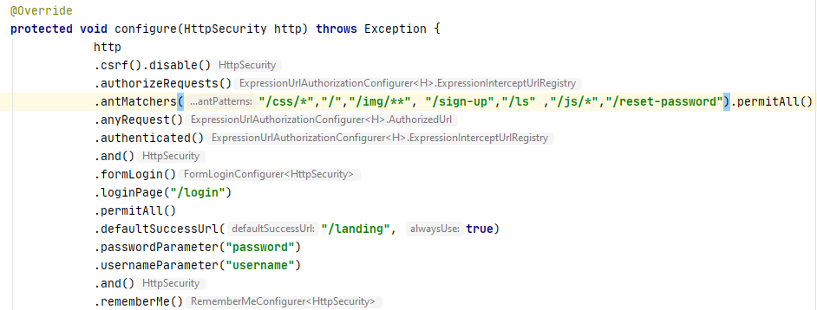
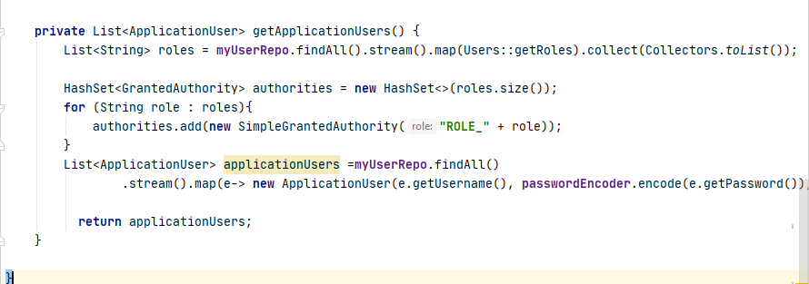
SPRING SECURITY

Slide 8
THYMELEAF

Slide 9
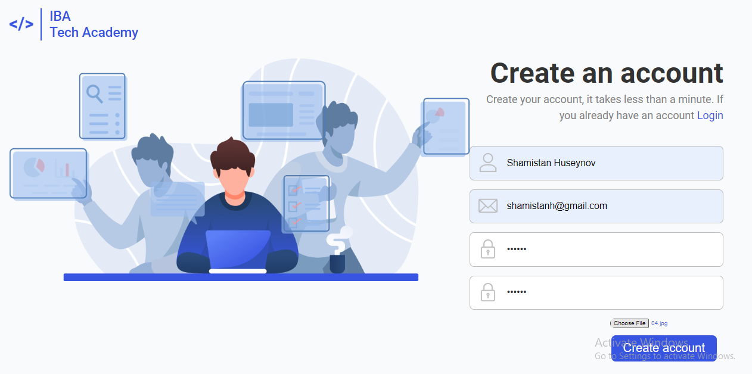
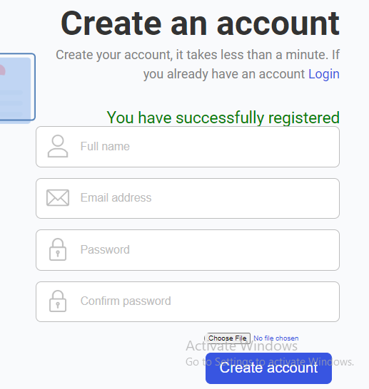
REGISTRATION

Slide 10
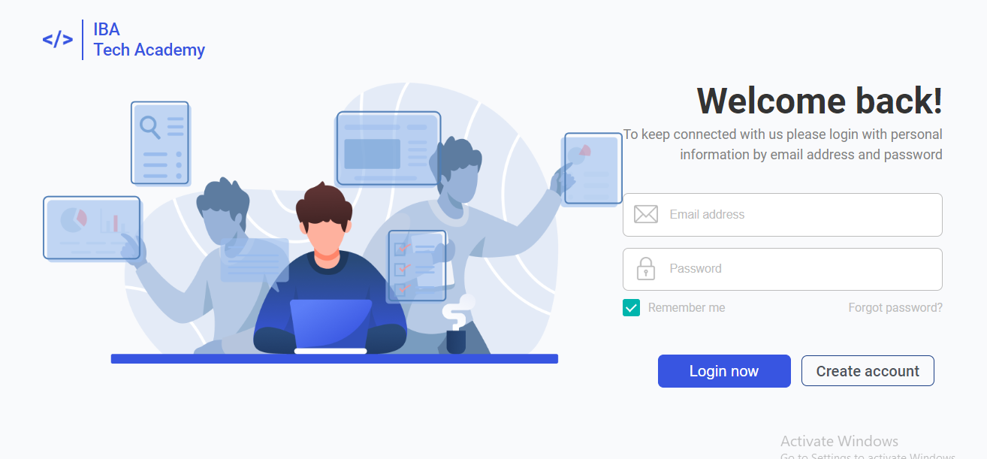
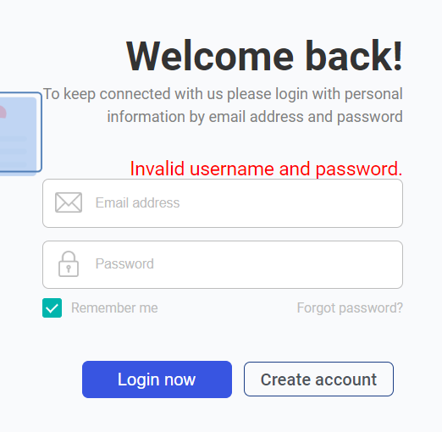
LOGIN

Slide 11

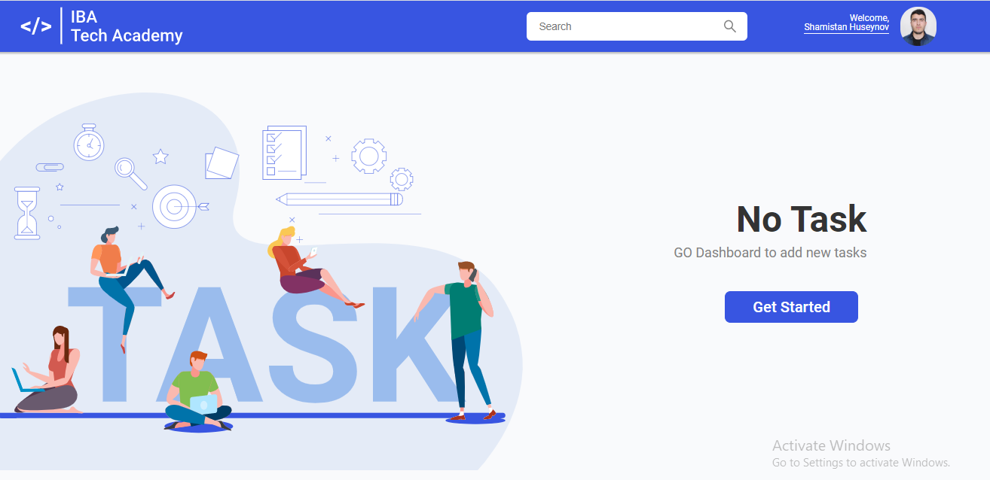
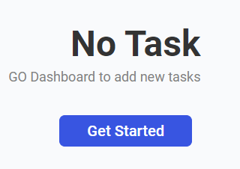
LANDING

Slide 12
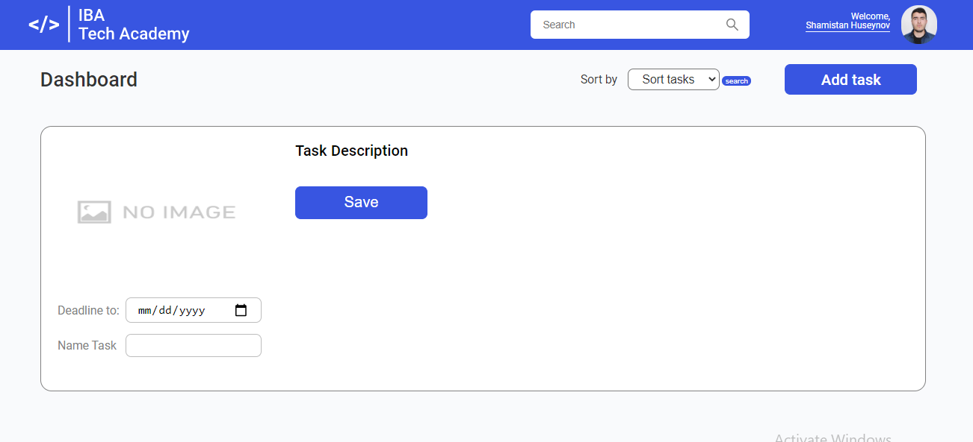

DASHBOARD

Slide 13
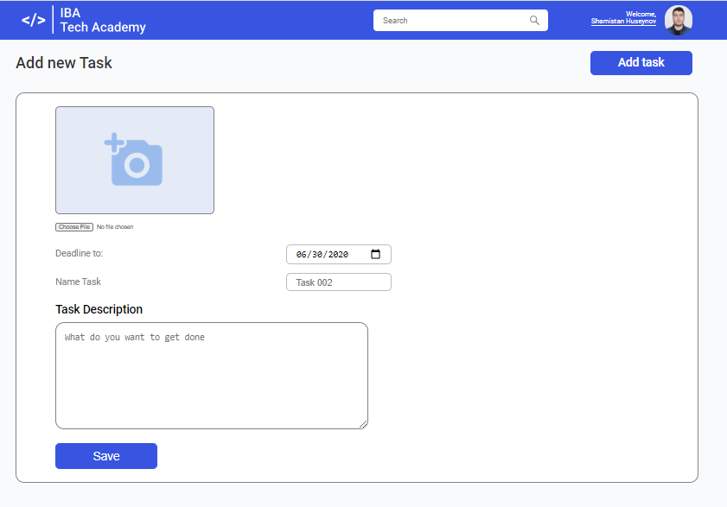
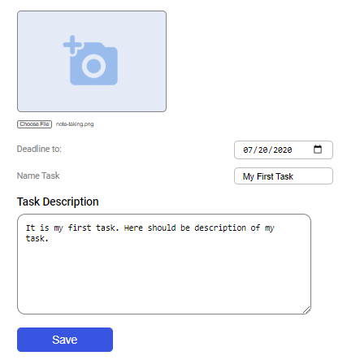
ADD TASK

Slide 14
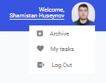
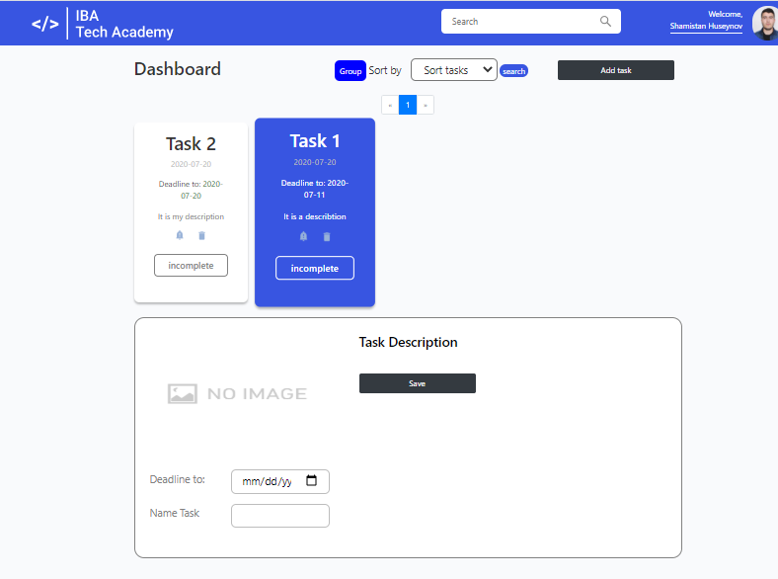

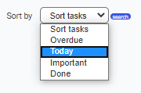


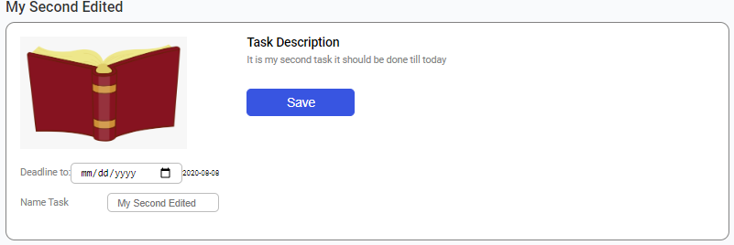

Slide 15
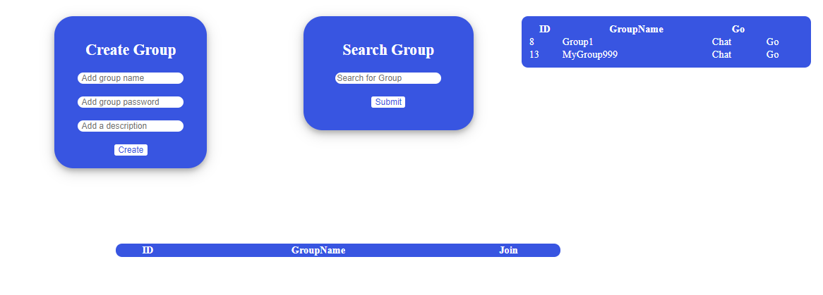
GROUP

Slide 16
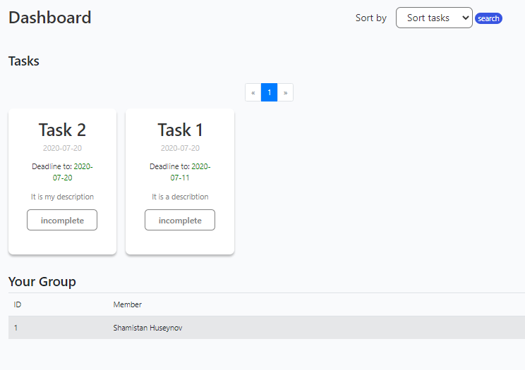
GROUP DASHBOARD

Slide 17
THANK YOU FOR YOUR ATTENTION

